Slide 1
Explainable Reasoning and Learning for Human-Robot Collaboration
Oliver Michael Kamperis
OXK312@student.bham.ac.uk
Intelligent Robotics Group
School of Computer Science
Primary Supervisor: Dr. Mohan Sridharan (90%)
Secondary Supervisor: Prof. David Parker (10%)
Notes:
The objective of this thesis is to provide robots with the ability to communicate with humans during a collaborative task.
To achieve this objective, this thesis will develop a decision making and reasoning model for robots which will enable them to provide explanatory descriptions of their beliefs, knowledge, experiences and reasoning processes, on-demand and at an appropriate abstraction level.

Slide 2
Thesis Motivations
New generations of robots have extensive functional capabilities.
Humans are reluctant to trust them to perform many important tasks or are not convinced they are fit for purpose.
There is concern that robot’s may make unfair or discriminatory decisions, develop biases, and risk human safety.
It is thus natural to expect robots to be explainable to provide:
Trust: Humans tend to trust systems that they believe they understand.
Accountability: Want to know if robots are to blame when things fail.
Debugging: Easier to fix faults in transparent systems.
Thrun, Toward a framework for human-robot interaction, 2004
Sheh, “Why did you do that?“ Explainable Intelligent Robots, 2017
Notes:
Emerging generations of robots are highly autonomous and have extensive functional capabilities, including for example, self driving cars and service robots.
And these robots are starting to be deployed outside of what one might call classical robotics domains such as those in manufacturing and industry.
So they will be operating in environments which were never originally designed for robots, i.e. they aren’t very robot inclusive and they will be interacting with a broad range of humans with varying levels of understand of robotics.
So there's a lot of autonomy going on but generally there is not much transparency as to why robots make decisions or why they behaviour in a certain way.
And this has lead to a lack of trust which I believe stems from the problem that people aren’t totally convinced that robots will operate effectively with a sufficiently low failure rate when performing important tasks, and I believe this comes from the fact that most people don’t understand the decision making and reasoning of robots.
Other common concerns that have arisen primarily from governments in the UK, USA and China that robot’s may make discriminatory decisions, replicate or develop biases against particular groups of people, or possibly put human safety at risk in highly sensitive environments.
Thus it seems quite natural to expect a robot to be explainable, to be able to describe its rationale and reasons behind its decisions, justify its choices and be accountable when things go wrong.
At least in the initial stages of deployment of human-robot collaborative robots one of the main motivators for explainability is to increase trust.
And finally of course, for developers, engineers, scientists, its useful to have a transparent and explainable system to work with, because it is much easier to find and fix faults in such a system, which ultimately will lead to a more robust system.

Slide 3
What is Human-Robot Collaboration?
Robot receives instructions, carries them out with little or no human supervision and must explain itself in retrospect of completing, or possibly failing to complete, its task.
Much past work has focused on interactive tasks in which there is a shared effort towards a common goal.
Proof-of-concept domains:
Office: A benchmark for common collaborative tasks.
Hospitality: More complex and expansive domain.
Construction: Safety critical and high commercial demand.
Doran, What does explainable AI really mean?, 2017
Langley et al, Explainable Agency for Intelligent Autonomous Systems, 2017
Notes:
Lets begin by defining what I mean by human-robot collaboration and what the scope of the tasks I am seeking to consider in this thesis.
In human-robot collaboration, will most frequently is that in which a robot receives instructions, carries them out, with little or no human interaction, then must explain itself in retrospect of extended unsupervised activity, having either succeeded or failed to complete its given goals.
A lot of past work focused on human-robot interaction, in which there is a shared effort towards some common goal, and explanations are usually provided throughout execution.
The human-robot collaborative task is more challenging, the robots must maintain a record of decisions made, knowledge it gained throughout execution amongst other things.
Storing and structuring this knowledge such that it supports explanation is still mostly unsolved in robotics.
Yet this type of scenario will occur very frequently in many domains of interest such as healthcare, hospitality and disaster rescue to name a few.
The proof of concepts domains I'll be using during my thesis will most likely be the following three:
A relatively basic office domain, which I will use effectively for benchmarking the system and checking individual components work is a quite simple situation.
A more complex domain is the hospitality domain, which I have detailed somewhat in my report, this is a more expansive domain and can include really anything I want, so it could be cooking or cleaning robots, porter robots, etc etc, and it’s a domain that has been researched a lot for the use of robotics and it has a lot of commercial interest.
Finally, there is the construction domain, which is a bit different, its highly structured and the range of tasks is more rigid and repetitive, but it has very high commercial interest and its also highly safety critical, such that you will mostly be wanting to allow the robots to operate on site without much supervision, but you will want them to be able to report of progress and explain when//if something goes wrong.

Slide 4
Explainable Artificial Intelligence (XAI)
Significant recent interest in XAI including the US Defence Advanced Research Projects Agency (DARPA) who launched the XAI program.
Calls for AI algorithms/systems to:
Justify their decisions and state when they will succeed or fail.
Allow the user to understand when it can trust the system.
This has focused heavily on predicting the input-output mapping of black-box models to allow interpretation of their decision making.
No insight into the underlying reasoning with which decisions are made, the beliefs that inform this, and the provenance of beliefs.
DARPA, Broad agency announcement: Explainable artificial intelligence (XAI), 2016
Rudin, Stop explaining black box machine learning models for high stakes decisions and use interpretable models instead, 2019
Notes:
This problem of a lack of transparency in current approaches has not gone unnoticed.
In recent years there has been substantial interest in explainable artificial intelligence.
A big name in that field has been DARPA who launched the XAI program in 2016, there document announcing that has about 350 citations according to google scholar so relatively popular.
DARPA calls for development of artificially intelligent algorithms and systems to include tools to justify decisions they make, state when they will succeed or when they are likely to fail, and allow the user to better understand when they are able to trust the system to perform as expected or required.
However, the majority of the research within the field of XAI has focused heavily of explaining black-box machine learning models.
And XAI in general seems to have spawned from the issue that many of the most popular current approaches to acquiring expertise in AI and robotics involve the use of black-box ML models which can produce powerful functional capabilities, but it is impossible to extract and explain content from such models.
Of course there are a number of approaches towards solving these problems, these include:
Learning simpler models that are easier to explain
Learning richer models that contain more explanatory content
Or by inferring approximate models (of the original decision making model) used solely for the purpose of explanation
However, all of these are generally insufficient for the needs of human-robot collaboration, and this is mainly because they cannot provide faithful explanations of the underlying reasoning with which decisions are made, the beliefs that inform this reasoning, and the provenance of those beliefs.
These include; stating actions it plans to execute towards its goals, its corresponding beliefs at each stage of its plan, and its episodic memory of past events.
Approximate explanations of ML models also require significant time to process and produce, therefore they cannot be provided as part of an interactive conversation, making them unsatisfactory for human-robot collaboration.

Slide 5
Explainability for Human-Robot Collaboration
Two main classes of approaches:
Explicable Planning: Robot generates plans such that they conform to the expectations of humans.
Often insufficient for many reasons including sacrifice of plan optimality and difficulties in determining human expectations.
Explainable Agency: Generate explanatory descriptions of its beliefs, knowledge and experiences, and how these guide its reasoning.
This allows robots to answer explanatory questions about their decisions by providing explanations of the reasoning underlying decision making.
Langley et al, Explainable Agency for Intelligent Autonomous Systems, 2017
Sreedharan, Balancing explicability and explanation in human-aware planning, 2017
Notes:
So of course there are many other approaches towards explainability.
From my literature review I’ve found that there are broadly two main classes of approaches that are most applicable to human-robot collaboration.
There are:
Explicable planning: This is a technique which attempts to make the behaviour of robots more transparent by injecting biases into a reasoning model such that decisions it makes, or plans it makes, conform to the expectations of humans. In this way the robot’s decisions become inherently easier to understand, because it does what we expect it to do. However, this technique is problematic because it requires sacrificing optimality in favour of explicability and it is difficult to actually determine the expectations of humans, there are also many scenarios in which conforming to human expectations is impossible because the enabling conditions of the expected decision have not been met.
Explainable agency: A robot generates explanatory descriptions of its beliefs, knowledge and experiences, and how these guide its reasoning about planning, diagnostics and inference. This allows robots to directly answer explanatory questions posed by human collaborators about decisions made by providing explanations of the reasoning underlying that decision making.
I will be focusing on explainable agency in this thesis as I believe it is the most promising and general approach towards explainability for human-robot collaboration.
So explainable agency requires a robot to generate natural language explanations in response to direct explanatory questions and thus allow humans to understand their decisions and behaviour.

Slide 6
What is an Explanation?
An explanation is an explanatory description of how ones knowledge and experiences informs their beliefs, how their beliefs guide their reasoning, and how their reasoning leads to their decisions.
Explanations are:
Answers to explanatory questions,
Made as part of a conversational process.
Humans often provide such explanations and robots should too.
The process of selecting, constructing and providing such explanations in robotics is referred to as explanation generation.
Lombrozo, The structure and function of explanations, 2006
Notes:
But what is an explanation?
I define an explanation in the following way:
An explanation is an explanatory description of how ones knowledge and experiences informs their beliefs, how their beliefs guide their reasoning, and how their reasoning leads to their decisions.
Explanations are answers, to explanatory questions.
This means that an explanation should explicitly answer a question by providing on the information relevant to the specific question and context under consideration.
This is in contrast to just plain transparency which just exposes an entire model and does not filter its content at all.
Explanations are also made as part of a conversational process, they are a social interaction, which is by its nature an interactive process, what this means is …
As humans we usually ask for and provide explanations in such a manner, and I argue that robots should also emulate this same process to order to provide for human friendly explanations.
The problem of selecting, constructing and providing such explanations in this manner is referred to as explanation generation.
I will speak a bit more about explanation generation and the specific part of that process I am focusing on in my thesis a little later.

Slide 7
Range of Explanations
What: “What do you expect the state a time T to be?”.
What-if: “Would your plan be valid given observation O at time T?”
Why: “Why did fluent F hold value V at time T?”
Why-constrastive: “Why did you take action A over B at time T?”
These can be constructed using a template based approach:
Determine correct template type for a given question,
Select content appropriate for given template type,
Refine this content and populate the template accordingly.
Miller, Explanation in Artificial Intelligence - Insights from the social sciences, 2019
Notes:
So this is not an exhaustive list, but it covers a large range of possible questions, because with regards to the content extraction phase, the technique for extracting knowledge relevant to a given
Its quite hard to account for all the possible questions that could be asked, of course some may not be relevant

Slide 8
Functional Abilities of an Explainable Agent
Based on the definition of an explanation, the following three high-level functional capabilities are identified which a robot must be enabled with to achieve explainable agency:
Explain decisions made during both plan generation and execution.
Describe how its knowledge, beliefs and experiences guided its reasoning and lead to its decisions.
Communicate all levels of its decision making and reasoning processes in human understandable terms and at a level of abstraction appropriate to the context.

Slide 9
Explanation Generation
How is it best to design a robot’s reasoning model such that it inherently supports the ability of explainable agency?
Impossible to extract and explain content from a model which does not represent that content such as to support such explanation.
Cannot design a reasoning model and attempt to explain it after the fact because the ability to explain is tightly linked to the Knowledge Representation and Reasoning methodology and its implementation.
To realise explainable agency, we must accept that black-box models are insufficient and develop transparent reasoning models.
Notes:
So we have a definition of an explanation and we know the abilities that we want to enable a robot with to support an explainable agency in the context of human-robot collaboration.
But how is it best to design a robot's reasoning model such that it inherently supports these abilities?
This is the primary research question of this thesis.
And this question stems from the fundamental concept that it is impossible to truly extract and explain from a model which does not represent that content such as to support such explanation.
So the knowledge elements that form the model such support explanation.
This means that we cannot just design a reasoning model and attempt to explain it after the fact because the ability to explain its content is tightly linked to the underling knowledge representation and reasoning methodology and their implementation in the design of the reasoning model.
So it seems clear that to support the abilities outlined previously that can cannot use black-box models if we wish to provide explanations faithful to our definition.

Slide 10
Explanation Generation
A transparent system allows humans to see and study its content.
However, a robot may and store vast quantities of information.
Simply exposing the entirety of a robot’s reasoning model in human-readable format does not by itself constitute explanation generation.
To generate understandable explanations robots must answer questions by providing only information relevant to that question.
Move between different descriptions of its reasoning model during a conversation until it arrives at the description the user desires.
Notes:
Ok so we will need a transparent model.
And I define a transparent model as, in a broad sense, one whose content can be seen and studied by a human.
Whether this transparency is only really understandable to an expert or is
But this is still problematic because an intelligent robot may process and story vast quantities of information during operation.
So simply exposing the entirety of a robot’s reasoning model in human-readable format does not by itself constitute explanation generation.
Because clearly this is over-informative and it will be far too time consuming to manually extract the information you want from the model.
So referring back to our definition of an explanation, an explanation is an answer to an explanatory question, so when a robot is asked a question it should answer that question by providing only the appropriate and most relevant information to that question.
And this requires additional components over just plain transparency, and we need to ensure that our model represents content to support this question answering process.
The last major point to make is based on

Slide 11
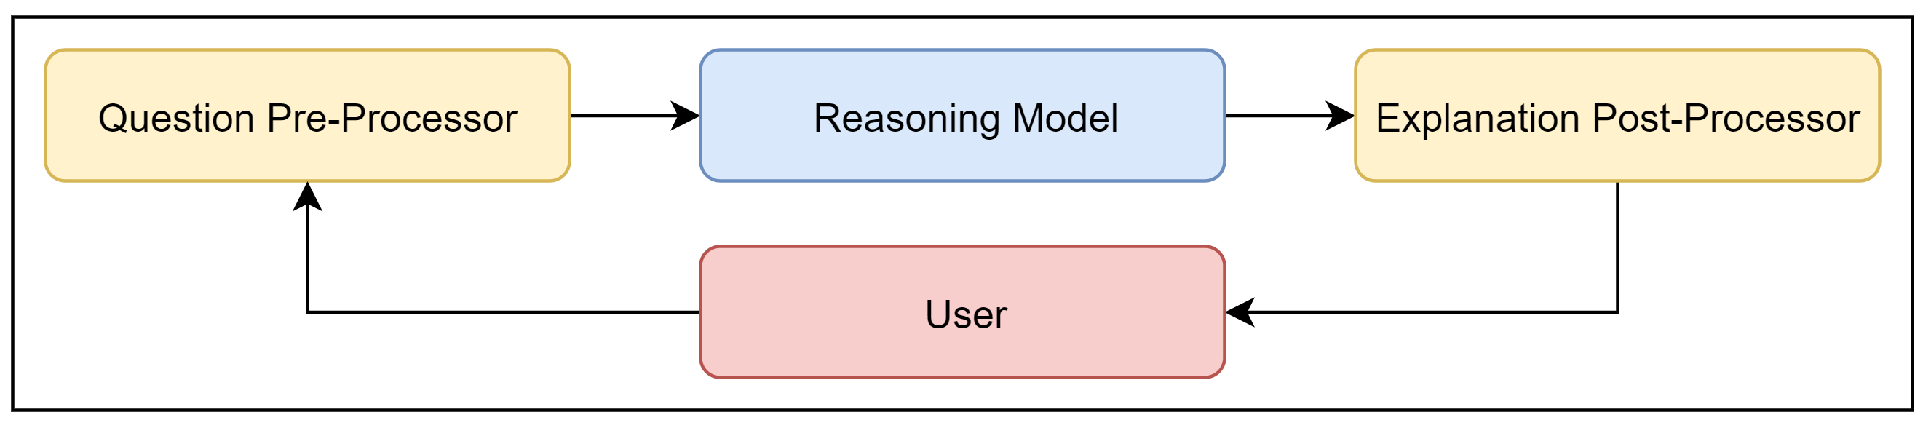
The Conversational Process
Decomposed into three distinct parts:
Question Reception
Content Extraction
Explanation Communication
This thesis concerns itself with developing the reasoning model such that it supports content extraction.
Existing tools for Natural Language Processing (NLP) will be used in the pre- and post-processing phases.
Notes:
This thesis will concern itself with developing a decision making and reasoning model for robots that intrinsically supports the content extraction phase.
This will require determining the range of explanations to be generated and binding to the architecture the requirements to generate all such explanations.

Slide 12
The Axes of Explanation
Representation abstraction – Models the abstraction level of an explanation, explanations can be coarse or fine.
Communication specificity – Models what the robot focuses on during communication, explanations can be brief or elaborate.
Communication verbosity – This axis models the comprehensiveness of the response provided, explanations can be simple or detailed.
An explainable robot should construct an explanation by:
Choosing a suitable position upon these axes,
Revise this choice based on human feedback.
Sridharan and Meadows, A theory of Explanations for Human-Robot Collaboration, 2019

Slide 13
Thesis Contributions
Develop a decision making and reasoning model for a robot collaborating with humans in which the ability to generate explanatory descriptions of its beliefs, knowledge and experiences, and how these guide all aspects of its reasoning about planning, diagnostics and inference, is fully coupled to the implementation.
Extend this decision making and reasoning model to support centralised and decentralised reasoning for teams of multiple robots with heterogeneous sensory and actuation abilities.
Notes:
So lets summarise and define exactly what the thesis contributions are.
The primary contribution is to develop a decision making and reasoning model for a robot collaborating with humans in which the ability to generate explanatory descriptions of its beliefs, knowledge and experiences, and how these guide all aspects of its reasoning about planning, diagnostics and inference is fully integrated and tightly coupled to the implementation at all levels.
I.e. this is a transparent system, which will have bound to it, all the components it requires to inherently support the abilities of explainable agency for human-robot collaboration, and to be able to generate human-understandable explanations according the definition of an explanation I outlined previously.
Secondly, and only as time permits, I want to extend this decision making and reasoning model to support a sufficient trade off between centralised and decentralised reasoning between teams of multiple robot with heterogenous sensory and actuation capabilities.
Now I’ve already implemented into my architecture some of the requirements for doing planning with multiple robots with heterogenous capabilities, the reason for that is because I wanted to add those parts before the system exploded in complexity and it would become far to complex to add the necessary components to the logic program to support this.
However, this is fully centralised planning for multiple robots which has been done before, and so has combined centralised and decentralised planning and diagnostics for multi-robots.
Where the interesting focus is on diagnosing network problems, i.e. problems in communicating and transferring knowledge, and that is the problem that I want to explain as the secondary contribution.

Slide 14
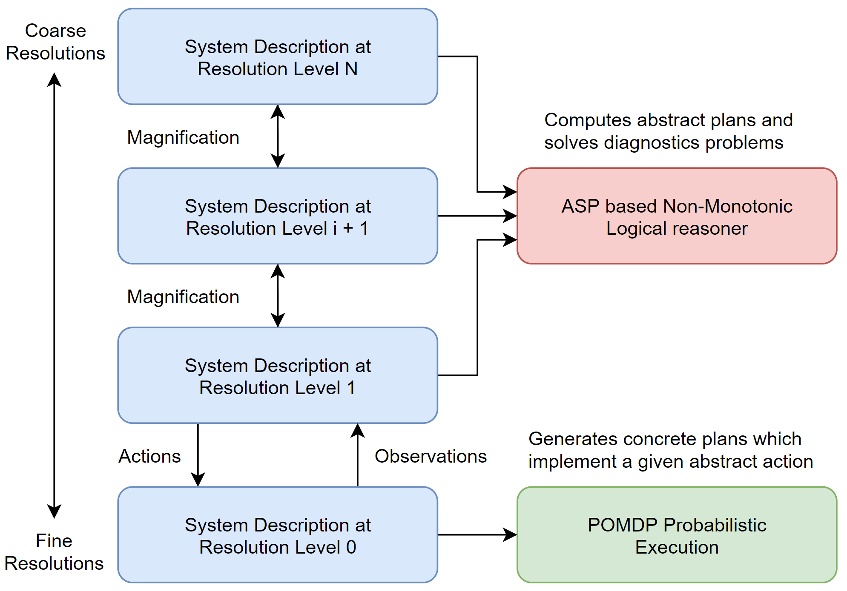
Proposed Architecture
Based on mixed logical and probabilistic reasoning.
Reasoning with tightly coupled transition diagrams of any given domain at multiple levels of resolution.
Computes abstract actions at each resolution level.
Each abstract action executed probabilistically.
Sridharan et al, REBA: A refinement-based architecture for knowledge representation and reasoning in robotics, 2019

Slide 15
Proposed Architecture
System descriptions encoded in action language ALd.
Descriptions translated into new ASP predicates to explain:
Effect and preconditions of actions,
Validity of states and state transitions,
Assumptions made about the initial domain state.
Maintains a recorded history of observations at multiple levels.
Performs diagnostics to explain unexpected observations via exceptions to initial defaults and hypothesising exogenous actions.
Notes:
The system descriptions are encoded in action language AL_d which is then translated into ASP using a set of predicates which I have introduced to aid explanation generation and particularly domain independency.
These allow explanations of the:
Effect and preconditions of actions,
Validity of states and state transitions,
Assumptions made about the initial domain state with the lack of complete explicit initial state knowledge.
The previous systems I’ve seen use a lot of domain dependent knowledge in the programs that work externally to the ASP system in order to generate explanations about these things.
They also allow me to do certain things in the diagnostics phase, such as automatically requesting observations for the effects of actions made at the previous step and preconditions of actions at the next step.
This effectively side steps the need to have explicit knowledge gathering “sense” actions.
They also provide me tools to explain the provenance of a robot’s beliefs in a much more domain-independent manner because it can automatically know what assumptions were used to define the initial state and what actions changed individual fluents.
I also done a lot of work on the diagnostics phase of the system to explain observations that contradict its beliefs by retracting assumptions made about the initial state, and/or hypothesising exogenous actions.
The system is able to reason enough to determine whether those observations require it to enter diagnostics, and can freely activate and deactivate those systems freely by a process know as selective grounding.

